Slide 1

ECE 2700
Digital Circuits
Register Design
Copyright © 2010 Frank Vahid
Instructors of courses requiring Vahid's Digital Design textbook (published by John Wiley and Sons) have permission to modify and use these slides for customary course-related activities, subject to keeping this copyright notice in place and unmodified. These slides may be posted as unanimated pdf versions on publicly-accessible course websites.. PowerPoint source (or pdf with animations) may not be posted to publicly-accessible websites, but may be posted for students on internal protected sites or distributed directly to students by other electronic means. Instructors may make printouts of the slides available to students for a reasonable photocopying charge, without incurring royalties. Any other use requires explicit permission. Instructors may obtain PowerPoint source or obtain special use permissions from Wiley – see http://www.ddvahid.com for information.

Slide 2
Today’s Objective
To become familiar with the various register designs

Slide 3
Roadmap
Combinational circuits
Sequential circuits (combinational logic + register)
  Before: Circuits based on control inputs (FSMs)
  Now: Circuits based on data inputs
    Aka: datapath components

Slide 4
Registers
N-bit registers (made up of N flip-flops)
  Today’s computers: 64-bit registers
    Store 64 bits
    64-bit wide, i.e., register width is 64 bits
Terminology
  Loading, writing, storing, updating a register
    Value stored in that register is changed
  Reading
    Non-destructive
    Usually asynchronous

Slide 5
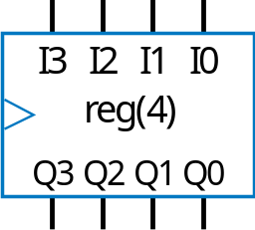
Register Design
I
3
I
2
I
1
I
0
4-bit register
D
D
D
D
Q
Q
Q
Q
clk
Q3
Q2
Q1
Q0
Basic register loads on every clock cycle
How to extend to only load on certain cycles?

Slide 6
Parallel-Load Register
Add 2x1 mux in front of each flip-flop
  Register’s load input selects mux input to pass
    load=0: existing flip-flop value
    load=1: new input value
Load | Operation
0 | Hold
1 | Load new data
I
3
I
2
I
1
I
0
1
0
1
0
1
0
1
0
load
2x1
D
D
D
D
I
3
I
2
I
1
I
0
load
Q
Q
Q
Q
Q3
Q2
Q1
Q0
Q3
Q2
Q1
Q0
block symbol
I
3
I
2
I
1
I
0
I
3
I
2
I
1
I
0
1
0
1
0
1
0
1
0
load=0
1
0
1
0
1
0
1
0
load=1
D
D
D
D
D
D
D
D
Q
Q
Q
Q
Q
Q
Q
Q
Q3
Q2
Q1
Q0
Q3
Q2
Q1
Q0
Notes:
Example: milk delivery to your house

Slide 7





Example
A digital system to display current USU’s basketball team ranking
Ranking
Register
0
0
0
0
1
1
1
0
Save
b
1
I
3
I
2
I
1
I
0
2
3
load
0
0
1
1
Current Ranking
clk
Q3
Q2
Q1
Q0
#3
3
Old Ranking

Slide 8
Question (AP)
Given the following timing diagram, what’s the register value at the time denoted by the red arrow?
  10
  15
  74
  2
  ☹
clk
save button
0 10 15 74 2 7
current value

Slide 9
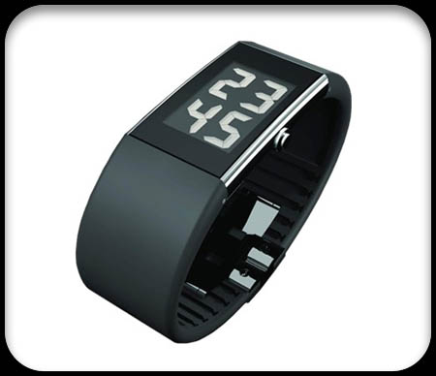

Example: Wristwatch Display
To reduce wires
  Write only 1 value
  at a time
  Loads into one
  of four registers
Number of wires from controller
  Naïve technique
  (wire each register separately):
  8+8+8+8 = 32 wires
  Now: 8+2+1+4 = 15 wires
0001010
C
8
d0
L
time
2x4
i0
1
1
8
d1
L
8-bit
a0
alarm
4
×
1
i0
0001010
0
i1
i1
8
a1
d2
L
d
D
stopwatch
8
i2
8
d3
L
date
1
e
load
i3
s1
s0
8
x
y

Slide 10
Shift Register
Shift right
  Move each bit one position right
  Rightmost bit is “dropped”
  Assume 0 shifted into leftmost bit
Q: Do four right shifts on 1001, showing value after each shift
1 1 0 1
Register contents
before shift right
0
0 1 1 0
Register contents
after shift right
1001 (original)
0100
How can we build a shift register?
0010
0001
0000

Slide 11
Shift Register Design
Use 2x1 muxes
  shr: “0” means hold, “1” shift
  shr_in: value to shift in
    May be 0 or 1
shr_in
shr
1
0
1
0
1
0
1
0
1
0
1
0
1
0
1
0
2x1
shr=1
2x1
D
D
D
D
D
D
D
D
Q
Q
Q
Q
Q
Q
Q
Q
Q3
Q2
Q1
Q0
Q3
Q2
Q1
Q0
How would you build a
left-shift register? How
about rotate?
shr_in
shr
Q3
Q2
Q1
Q0

Slide 12
Rotate Register
Rotate right: Like shift right,
but leftmost bit comes
from rightmost bit
1 1 0 1
Register contents
before shift right
1 1 1 0
Register contents
after shift right

Slide 13
Why Shift Register?
Many real-world applications
A well-known example
  Serial data communication
    USB, Bluetooth, WiFi

Slide 14
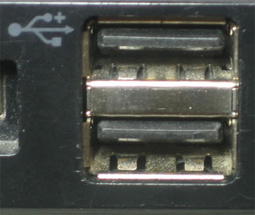
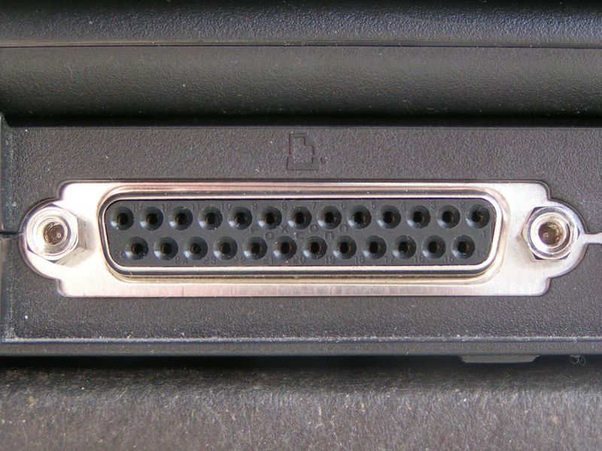
USB
USB – Universal Serial Bus
  One bit at a time
  Less crosstalk problem
    Faster communication (because data can be transmitted at a higher frequency)
  Fewer wires: cheaper, smaller

Slide 15
Question (AP)
Consider a 4-bit shift register with
  Initial value of 0110
  Serial input: 1011100 (LSB first)
What is the register value after shifting right 6 times?
  0111
  1111
  1011
  1101
  None of the above

Slide 16
Today’s Objective
To become familiar with the various register designs

Slide 17
Question
Problem 4.1 in the main textbook

